Slide 1
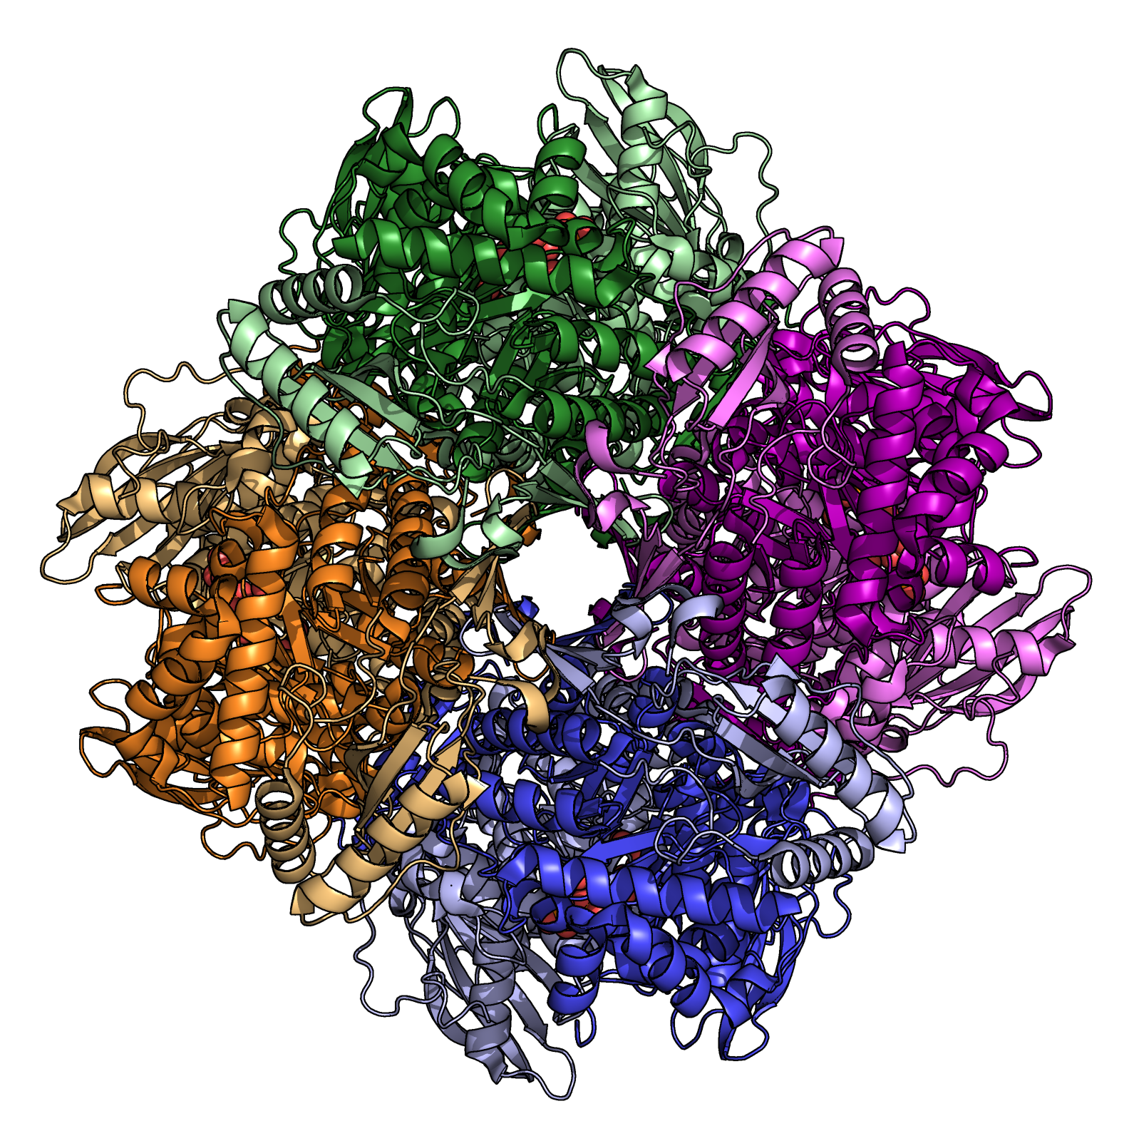
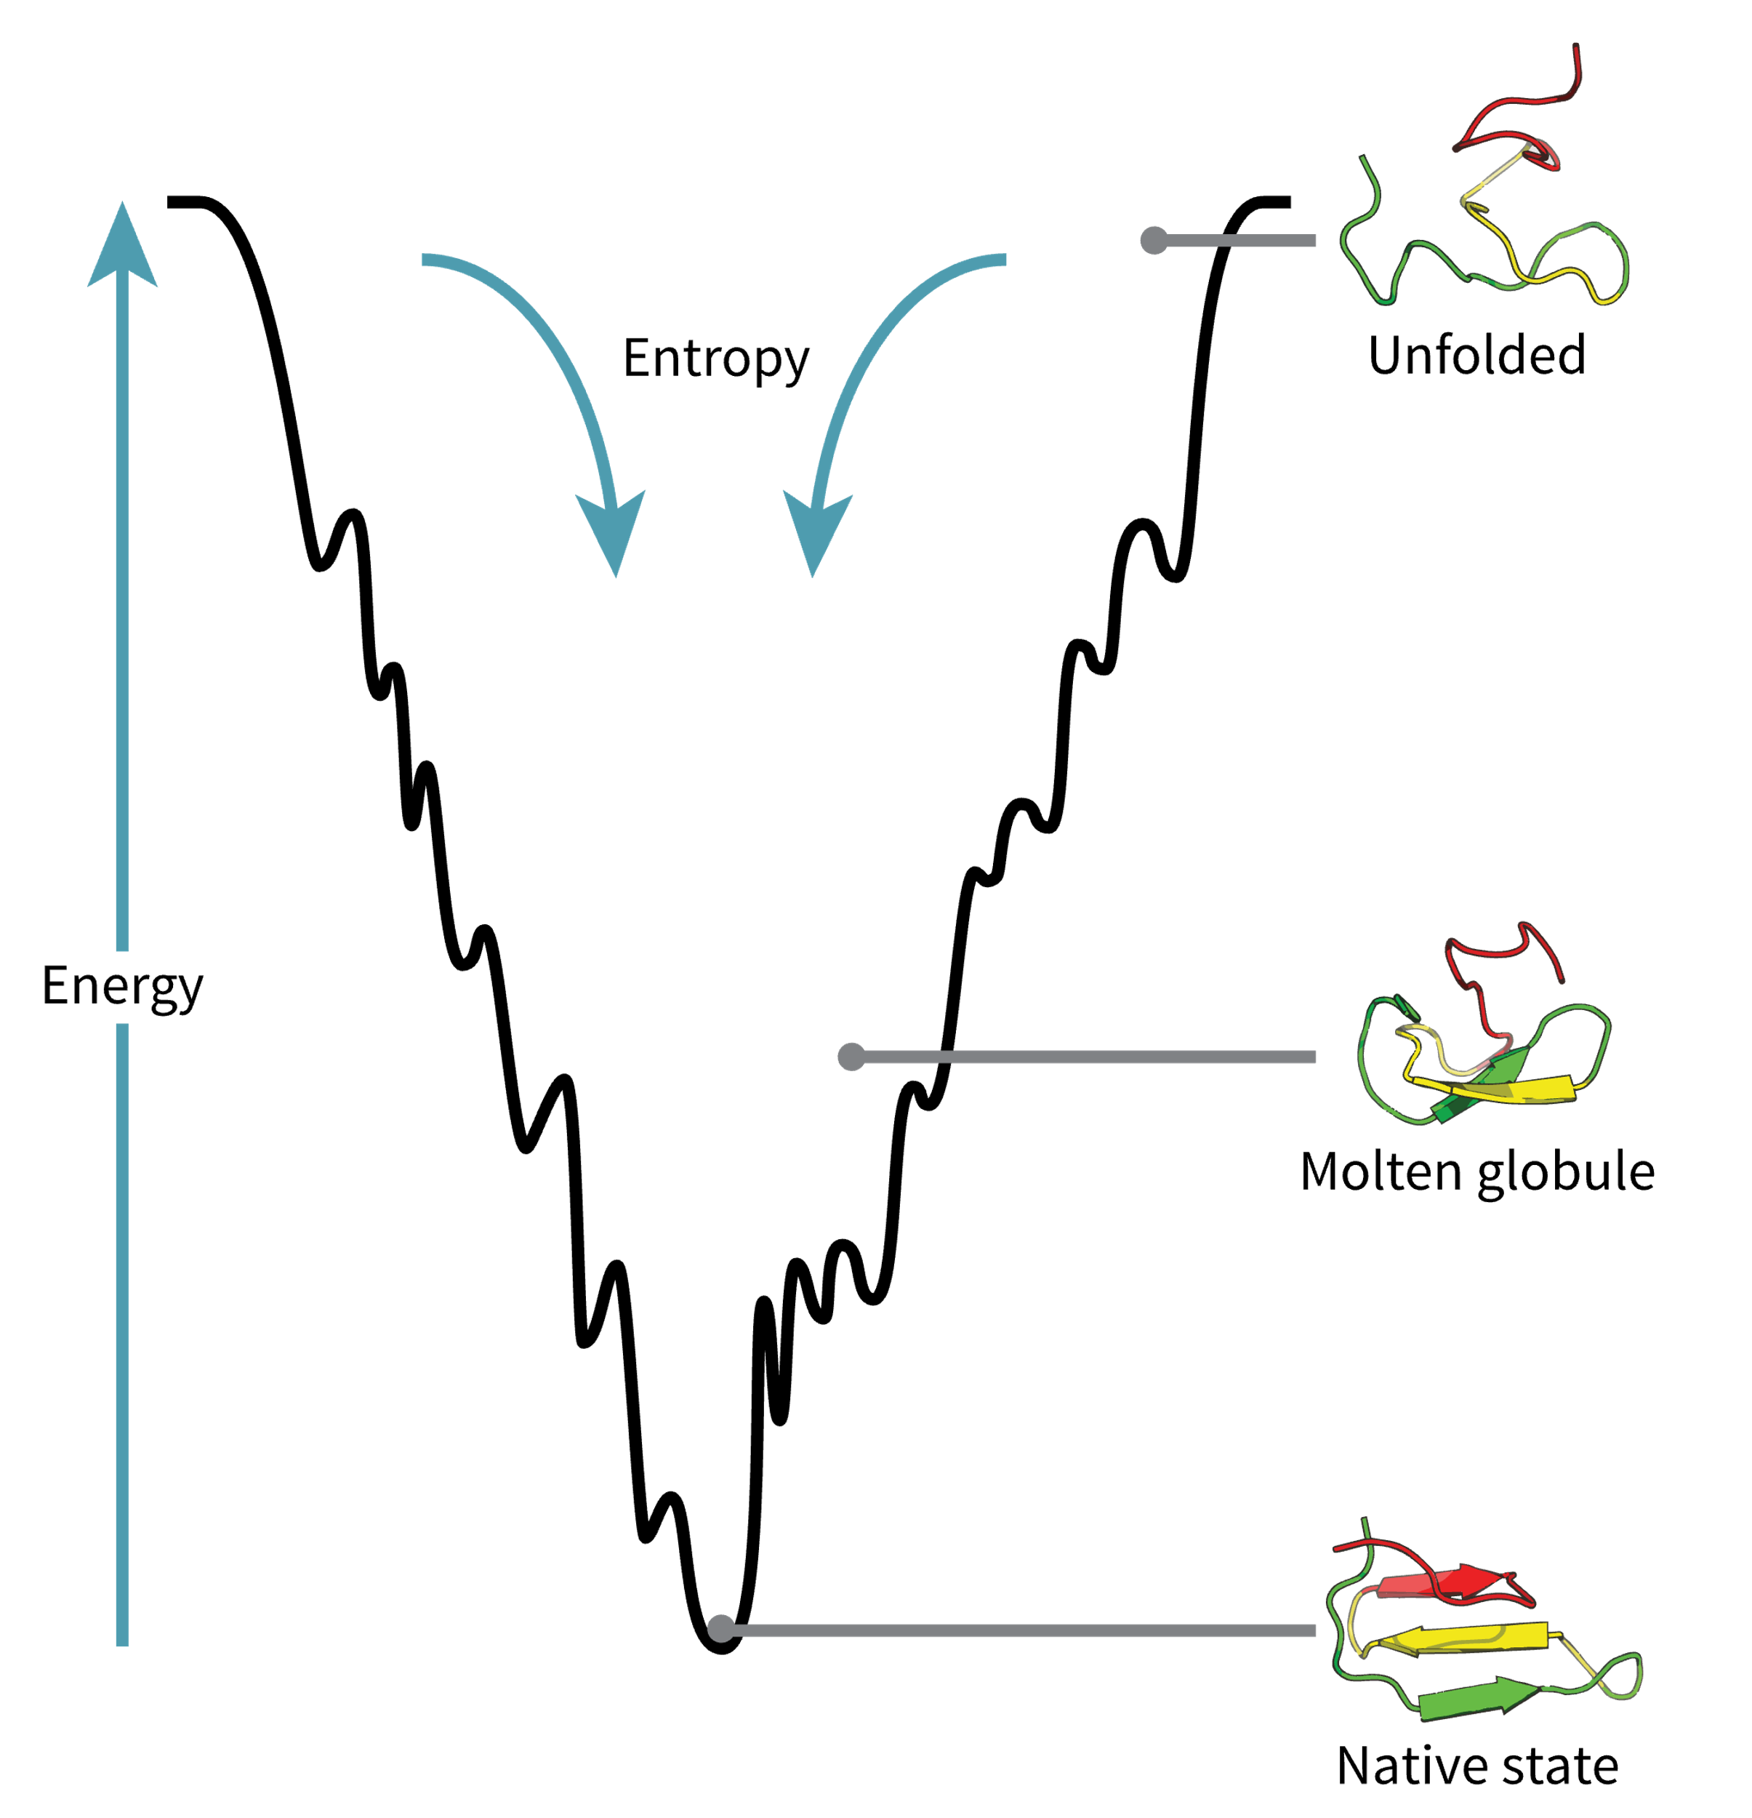


Protein
Structure &
Thermodynamics
Workshop
10th February 2025
Dr. Amanda Souza Câmara, IPK
Dr. Victor H. Rabesquine Nogueira, IPK
Prof. Dr. Antônio José da Costa Filho, University of São Paulo

Slide 2
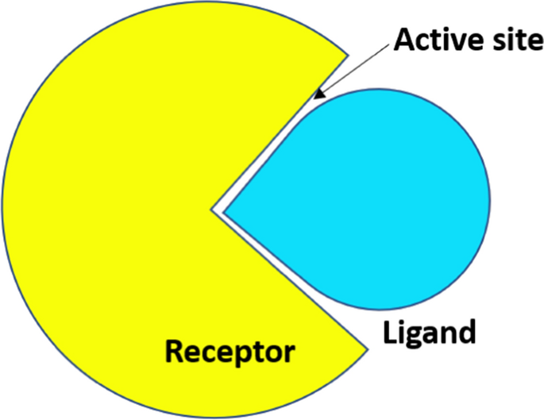
Molecular Docking
Molecular docking is a computational method that predicts the preferred orientation of a ligand when bound to a target molecule (usually a protein) to form a stable complex.
https://doi.org/10.1007/s00706-023-03076-1

Slide 3
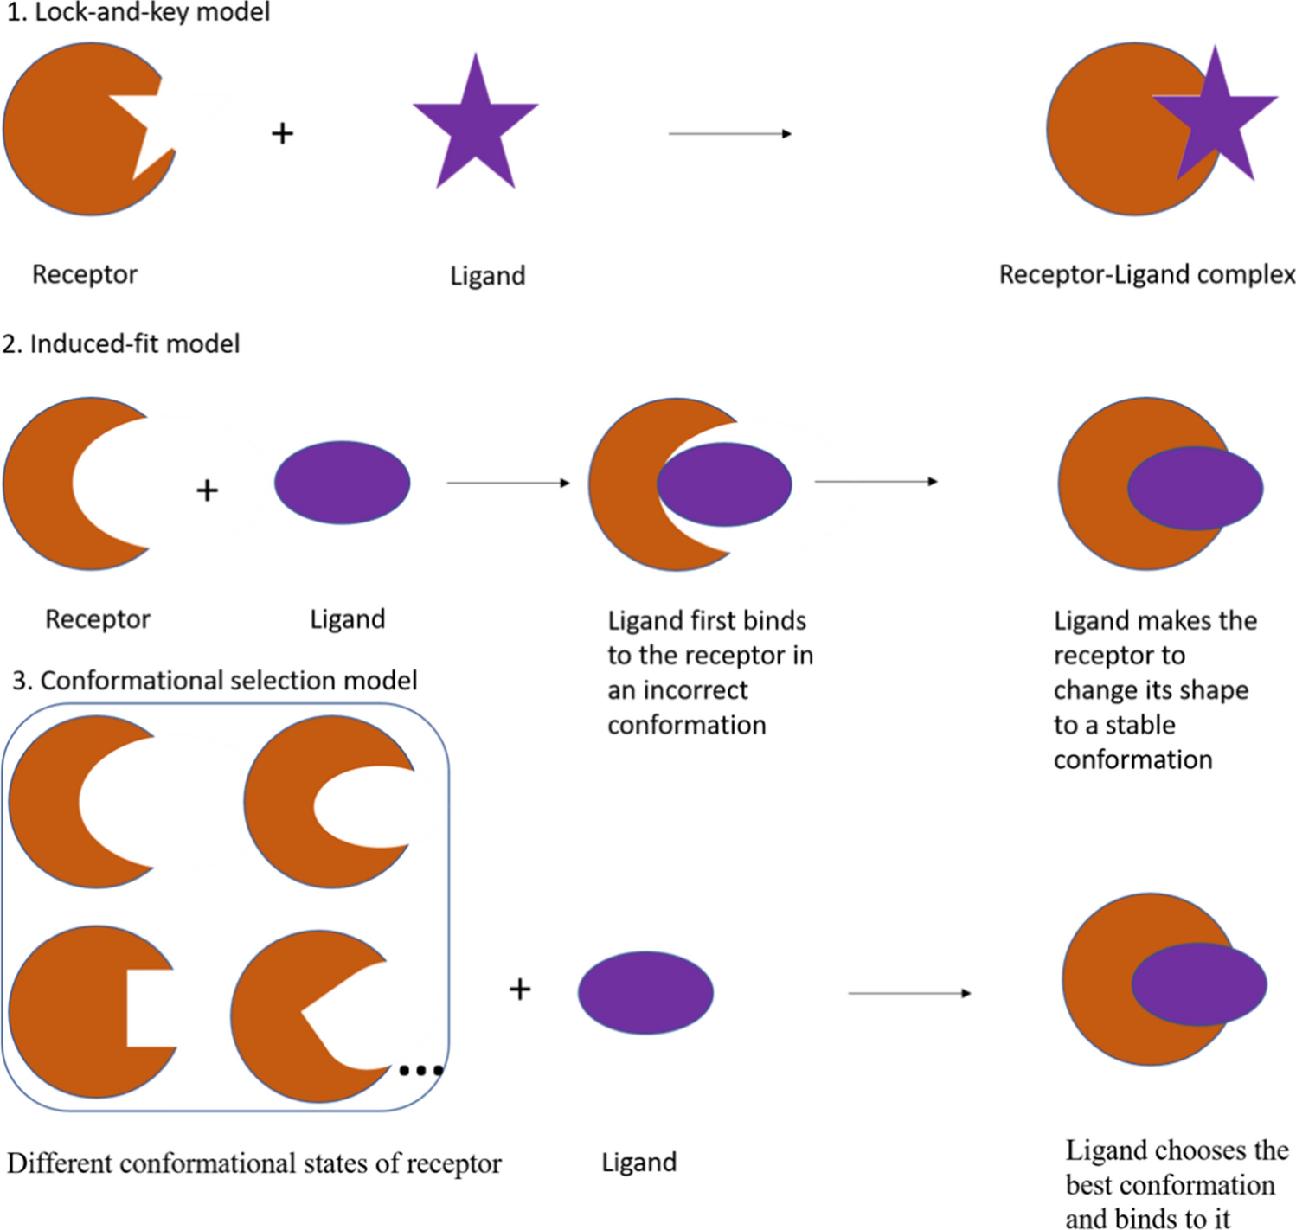
Molecular Docking
Molecular docking is a computational method that predicts the preferred orientation of a ligand when bound to a target molecule (usually a protein) to form a stable complex.
https://doi.org/10.1007/s00706-023-03076-1

Slide 4
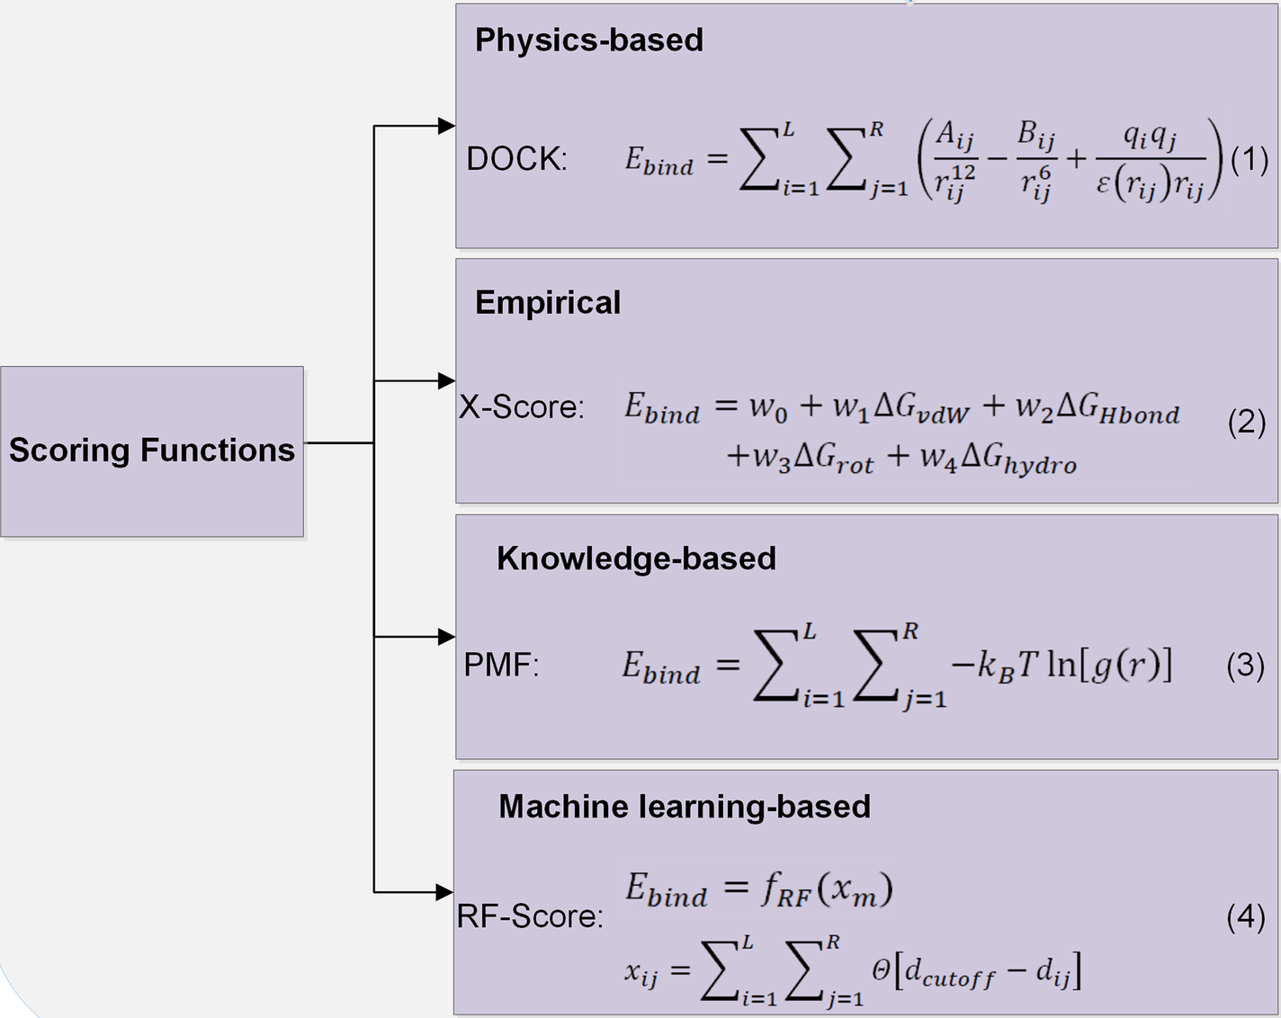
Molecular Docking
Molecular docking is a computational method that predicts the preferred orientation of a ligand when bound to a target molecule (usually a protein) to form a stable complex.
https://doi.org/10.1007/s00706-023-03076-1
https://doi.org/10.1007/s12539-019-00327-w

Slide 5
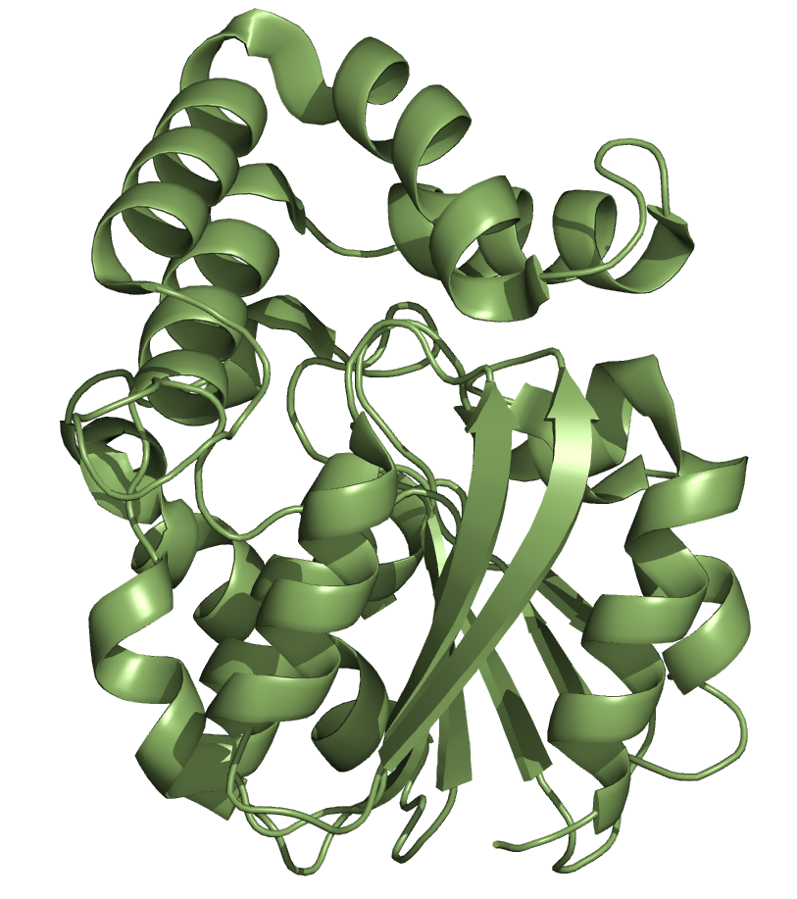
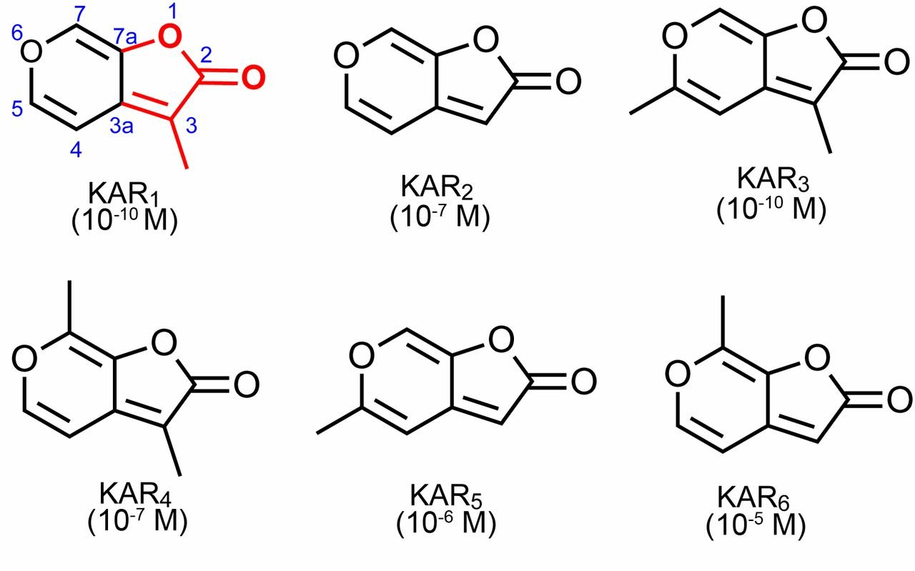
DockThor home page
PDB ID: 4JYM
Classification: HYDROLASE
Organism: Arabidopsis thaliana
Method: X-RAY DIFFRACTION
Resolution: 1.35 Å
Karrikins-insensitive 2 (KAI2)
https://doi.org/10.1073/pnas.1306265110

Slide 6
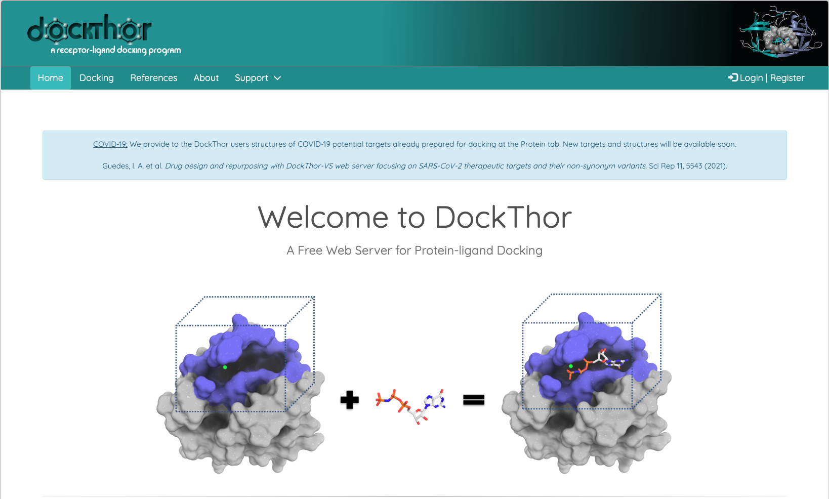
DockThor home page
DockThor® is a free protein-ligand docking server developed by the Grupo de Modelagem Molecular em Sistemas Biológicos at the National Laboratory for Scientific Computing (LNCC/MCTIC), from Brazil. The implemented program is a flexible-ligand and rigid-receptor grid-based method that employs a multiple solution genetic algorithm and the MMFF94S molecular force field scoring function for pose prediction.
To access the portal you should go to: https://dockthor.lncc.br/v2/

Slide 7
DockThor home page
Although the platform does not require a user account to be used, you can create one if you want to have access to your history of submitted jobs. However, only providing your email at the end of the process is enough to retrieve your results.

Slide 8
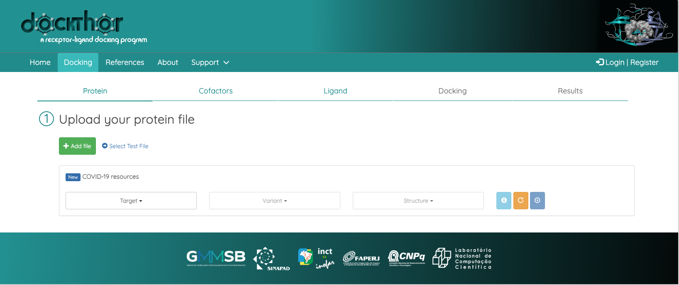
DockThor Docking page
To start your molecular docking, you should access the “Docking” portal by clicking on the refered button at the top left side of the page.

Slide 9
DockThor Docking page
This will provide an interface with a sequential steps/tabs you will follow to perform your desired docking.

Slide 10
DockThor Docking page
In the “Protein” tab, you should add your predicted protein file, using the Protein Data Bank file extension (.pdb).

Slide 11
DockThor Docking page
In the “Protein” tab, you should add your predicted protein file, using the Protein Data Bank file extension (.pdb)
Now you should add one out of your predicted structures, retrieved from AlphaFold.

Slide 12
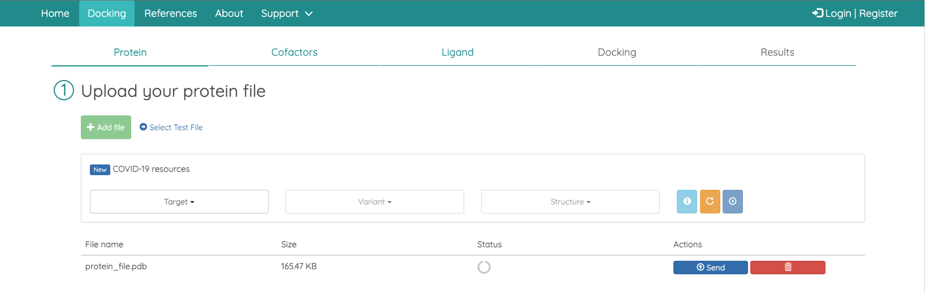
DockThor Docking page
In the “Protein” tab, you should add your predicted protein file, using the Protein Data Bank file extension (.pdb)
Now you should add one out of your predicted structures, retrieved from AlphaFold.
Once added, you can click on the “send” button.

Slide 13
DockThor Docking page
In the “Protein” tab, you should add your predicted protein file, using the Protein Data Bank file extension (.pdb)
After sending your protein file, DockThor will automatically parametrize the protein atoms using the MMFF94 atomic types and partial charges. It will also complete all the missing side chains, and will add polar hydrogen atoms when needed.
Now you should add one out of your predicted structures, retrieved from AlphaFold.
Once added, you can click on the “send” button

Slide 14
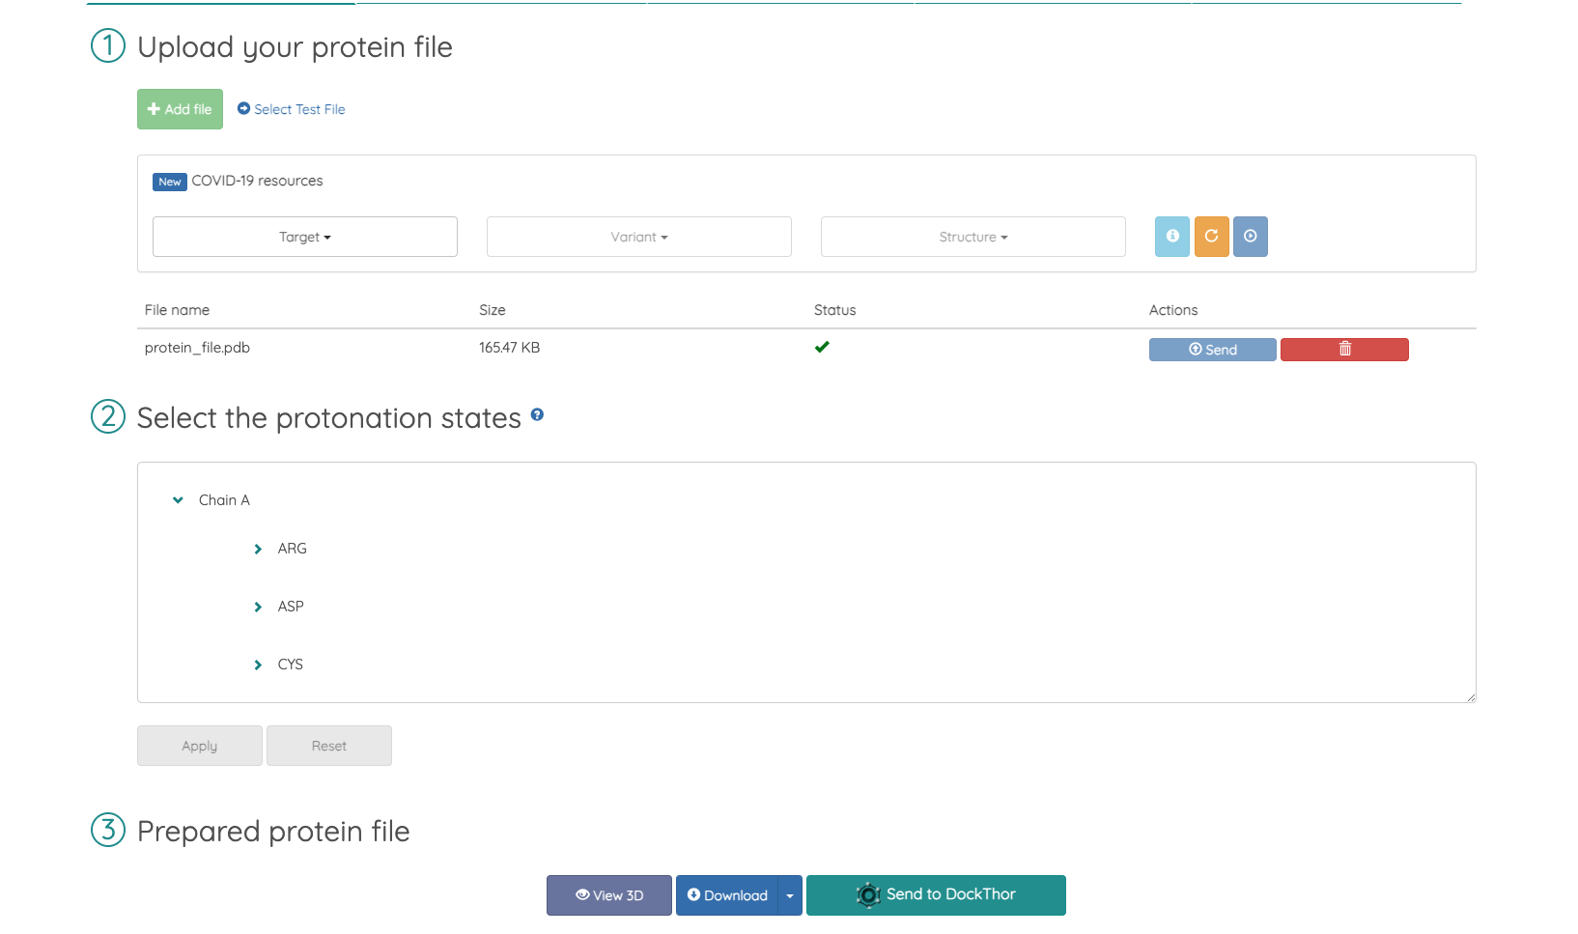
DockThor Docking page
Once the parametrization is complete, you will be able to select the protonation states of the amino acid residues.

Slide 15
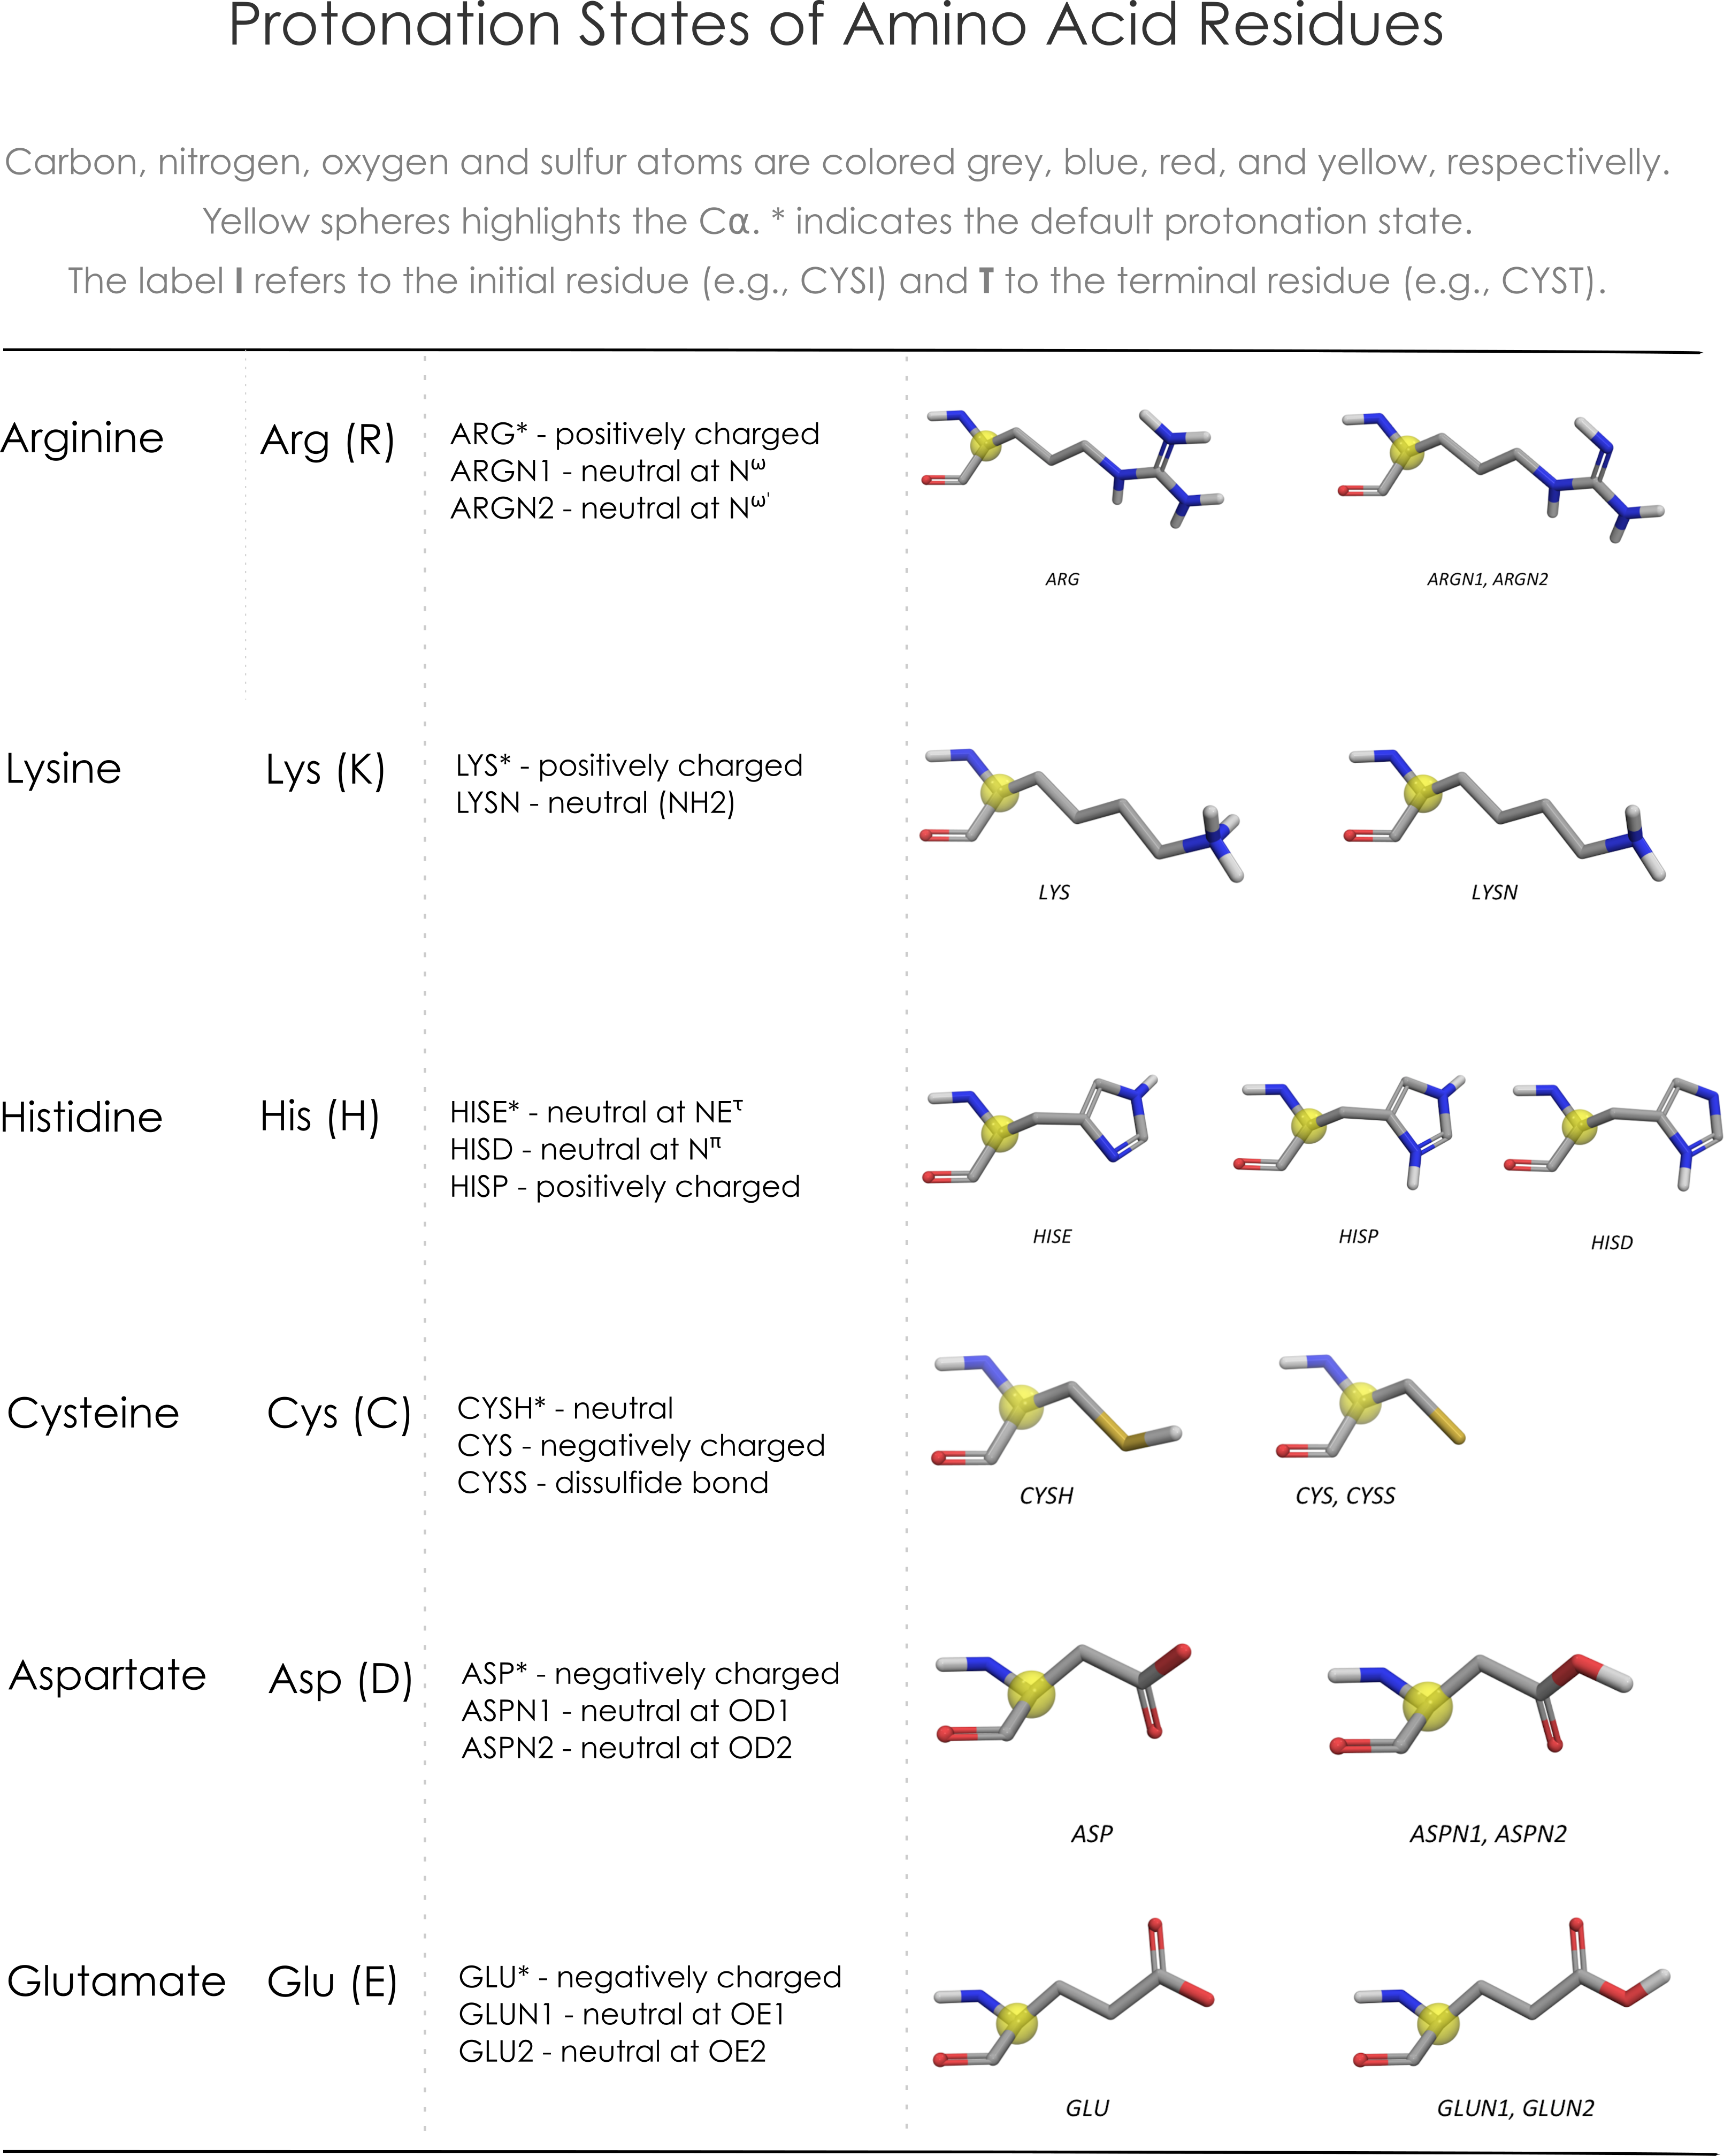
DockThor Docking page
Once the parametrization is complete, you will be able to select the protonation states of the amino acid residues.
By clicking on the “?” symbol, a list of possible protonation states options will be displayed.

Slide 16
DockThor Docking page
Once the parametrization is complete, you will be able to select the protonation states of the amino acid residues.
By clicking on the “?” symbol, a list of possible protonation states options will be displayed.
This approach will be more significative if you know the ideal pH of your protein, which are the amino acids involved in the desired function, and which are the proper protonation states.

Slide 17
DockThor Docking page
Once the parametrization is complete, you will be able to select the protonation states of the amino acid residues.
By clicking on the “?” symbol, a list of possible protonation states options will be displayed.
This step will be more significative if you know the ideal pH of your protein, which are the amino acids involved in the desired function, and which are the proper protonation states.
For the purposes of this tutorial, we will not change the default parameters.

Slide 18
DockThor Docking page
Once the parametrization is complete, you will be able to select the protonation states of the amino acid residues.
By clicking on the “?” symbol, a list of possible protonation states options will be displayed.
This step will be more significative if you know the ideal pH of your protein, which are the amino acids involved in the desired function, and which are the proper protonation states.
Click on “Send to DockThor” to go to the next step.
For the purposes of this tutorial, we will not change the default parameters.

Slide 19
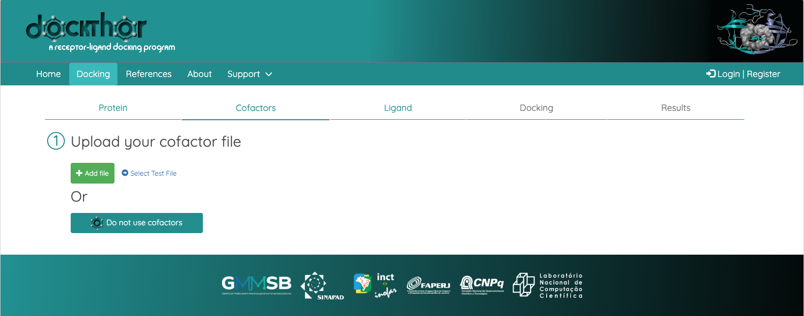
DockThor Docking page
The next step is the moment you decide either you want to add a cofactor or not.

Slide 20
DockThor Docking page
The next step is the moment you decide either you want to add a cofactor or not
Some protein-ligand complexes requires you to take cofactors (e.g. Zn, Mn, Fe, NAD, etc.) and/or water molecules into account. DockThor allows you to upload such molecules as .pdb files by clicking on the “Add file” button.

Slide 21
DockThor Docking page
The next step is the moment you decide either you want to add a cofactor or not.
Some protein-ligand complexes requires you to take cofactors (e.g. Zn, Mn, Fe, NAD, etc.) and/or water molecules into account. DockThor allows you to upload such molecules as .pdb files by clicking on the “Add file” button.
Be careful! All the hydrogen atoms that are added to the cofactor molecules do not consider de protein-ligand complex. If you decide to proceed with this option, you should use an external software to optimize the hydrogen bonds within the complex!

Slide 22
DockThor Docking page
The next step is the moment you decide either you want to add a cofactor or not
Some protein-ligand complexes requires you to take cofactors (e.g. Zn, Mn, Fe, NAD, etc.) and/or water molecules into account. DockThor allows you to upload such molecules as .pdb files by clicking on the “Add file” button
For the purposes of this tutorial, we will not change the default parameters.

Slide 23
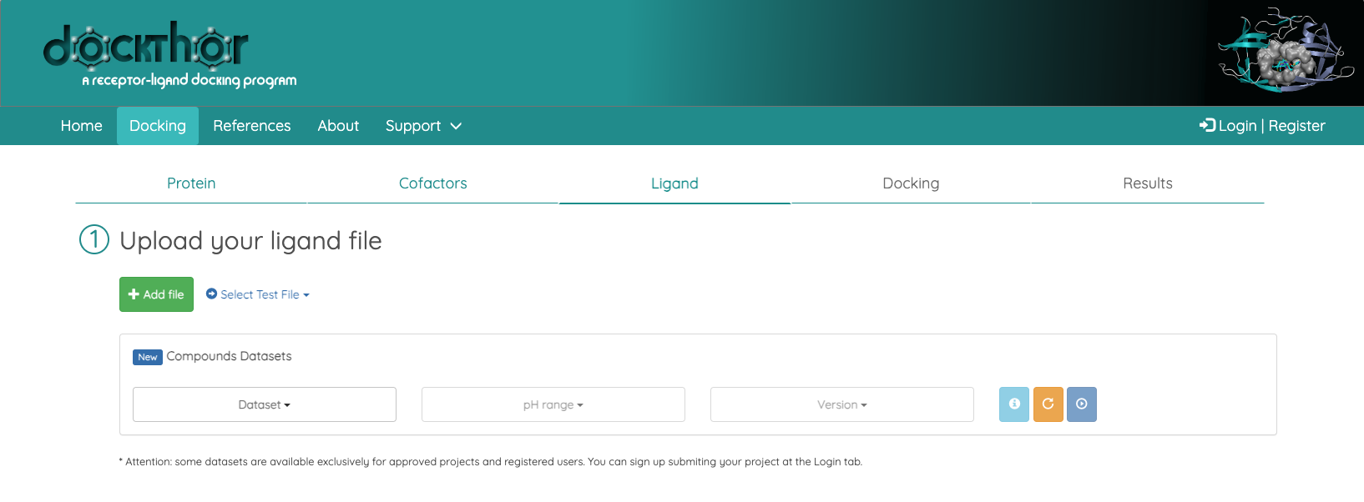
DockThor Docking page
Next step will be the ligand one.
You can add the ligand files, using .pdb, .mol2, and .sdf extensions, by clicking on the “Add file” button.

Slide 24
DockThor Docking page
Next step will be the ligand one.
You can add the ligand files, using .pdb, .mol2, and .sdf extensions, by clicking on the “Add file” button.
Use ligand1.mol2 or ligand2.mol2 file from the workshop directory.

Slide 25
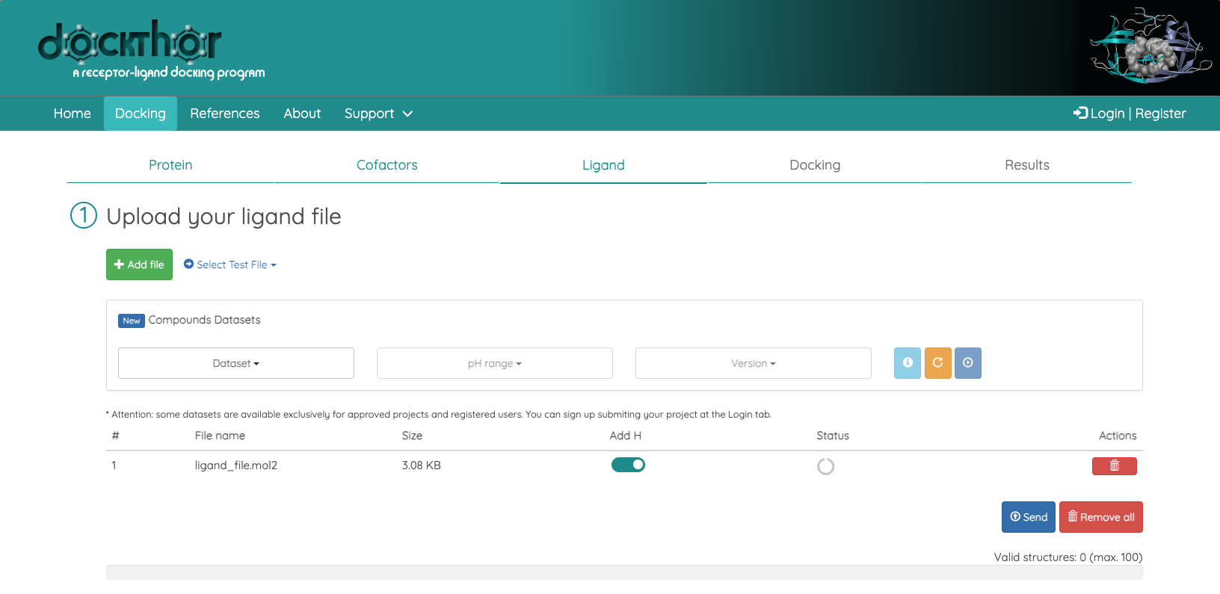
DockThor Docking page
Next step will be the ligand one.
You can add the ligand files, using .pdb, .mol2, and .sdf extensions, by clicking on the “Add file” button
Once you have added the ligand file, you should add the hydrogens to it, and click on “Send”

Slide 26
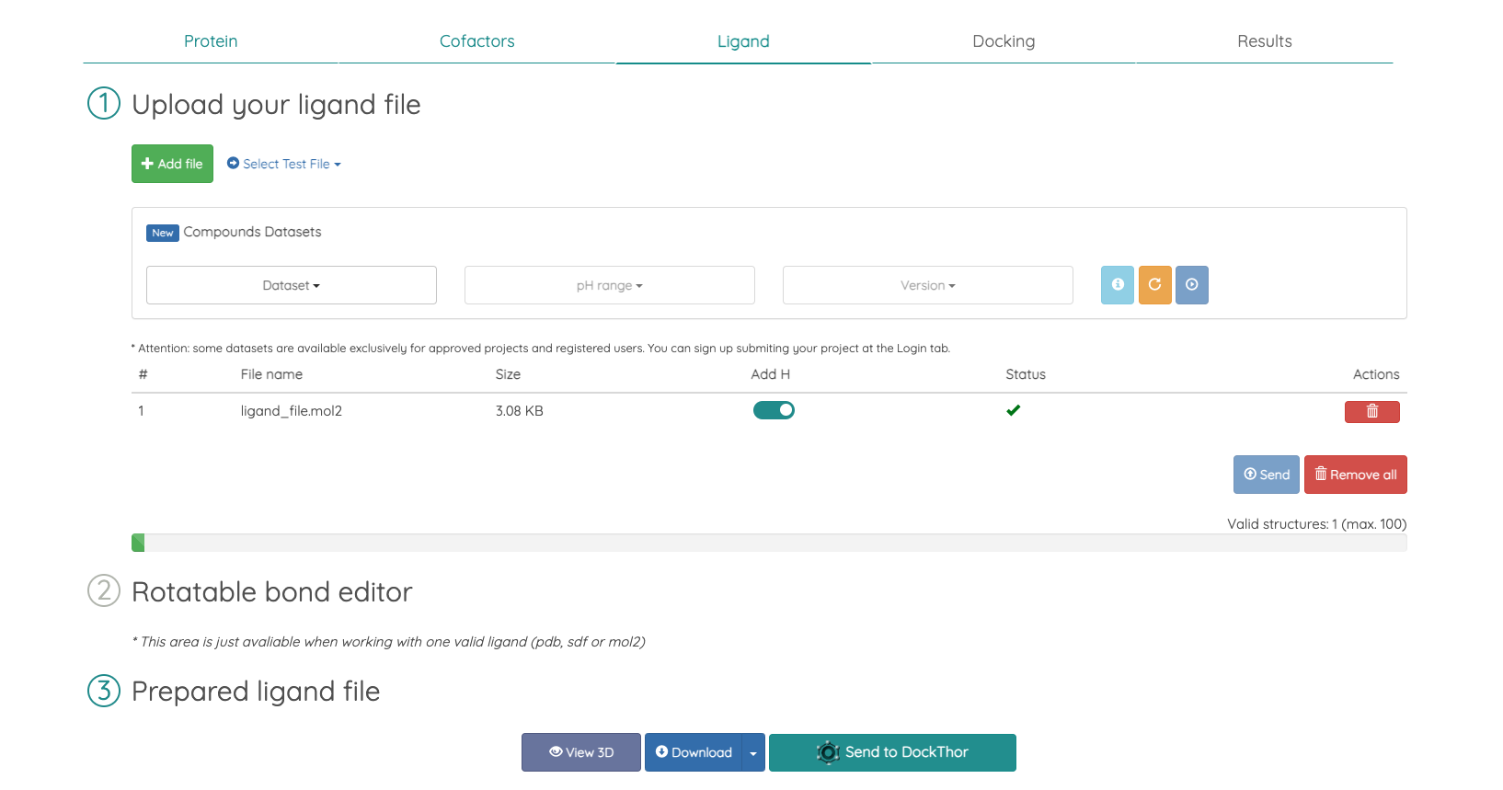
DockThor Docking page
Next step will be the ligand one.
You can add the ligand files, using .pdb, .mol2, and .sdf extensions, by clicking on the “Add file” button.
Once you have added the ligand file, you should add the hydrogens to it, and click on “Send”.
As the chosen ligand has no rotatable bonds, this field will not be available for selection. For other cases, you will get a greater set of poses if you enable all the rotatable bonds.

Slide 27
DockThor Docking page
Next step will be the ligand one.
You can add the ligand files, using .pdb, .mol2, and .sdf extensions, by clicking on the “Add file” button.
Once you have added the ligand file, you should add the hydrogens to it, and click on “Send”.
Click on the “Send to DockThor” button to go to the next step.
As the chosen ligand has no rotatable bonds, this field will not be available for selection. For other cases, you will get a greater set of poses if you enable all the rotatable bonds

Slide 28
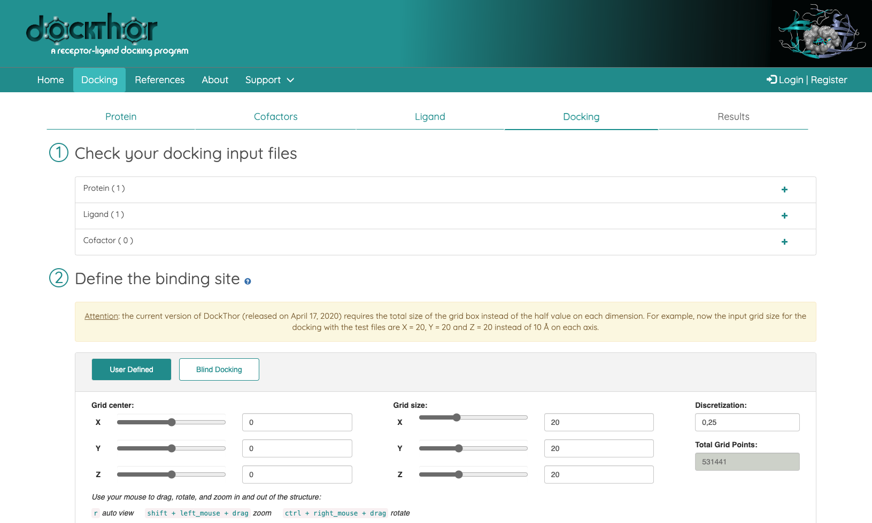
DockThor Docking page
In the last tab you can review the files you have added.

Slide 29
DockThor Docking page
In the last tab you can review the files you have added.
In this tab you will also define the binding site within your protein, in terms of a “search box,” which is a defined space where the algorithm searches for the optimal position and orientation of the ligand relative to the protein. For this purpose, you have two options:
Set your own box center, dimensions, and distances between the points of the box, based on the protein biding site;
Let the entire protein to be searched.

Slide 30
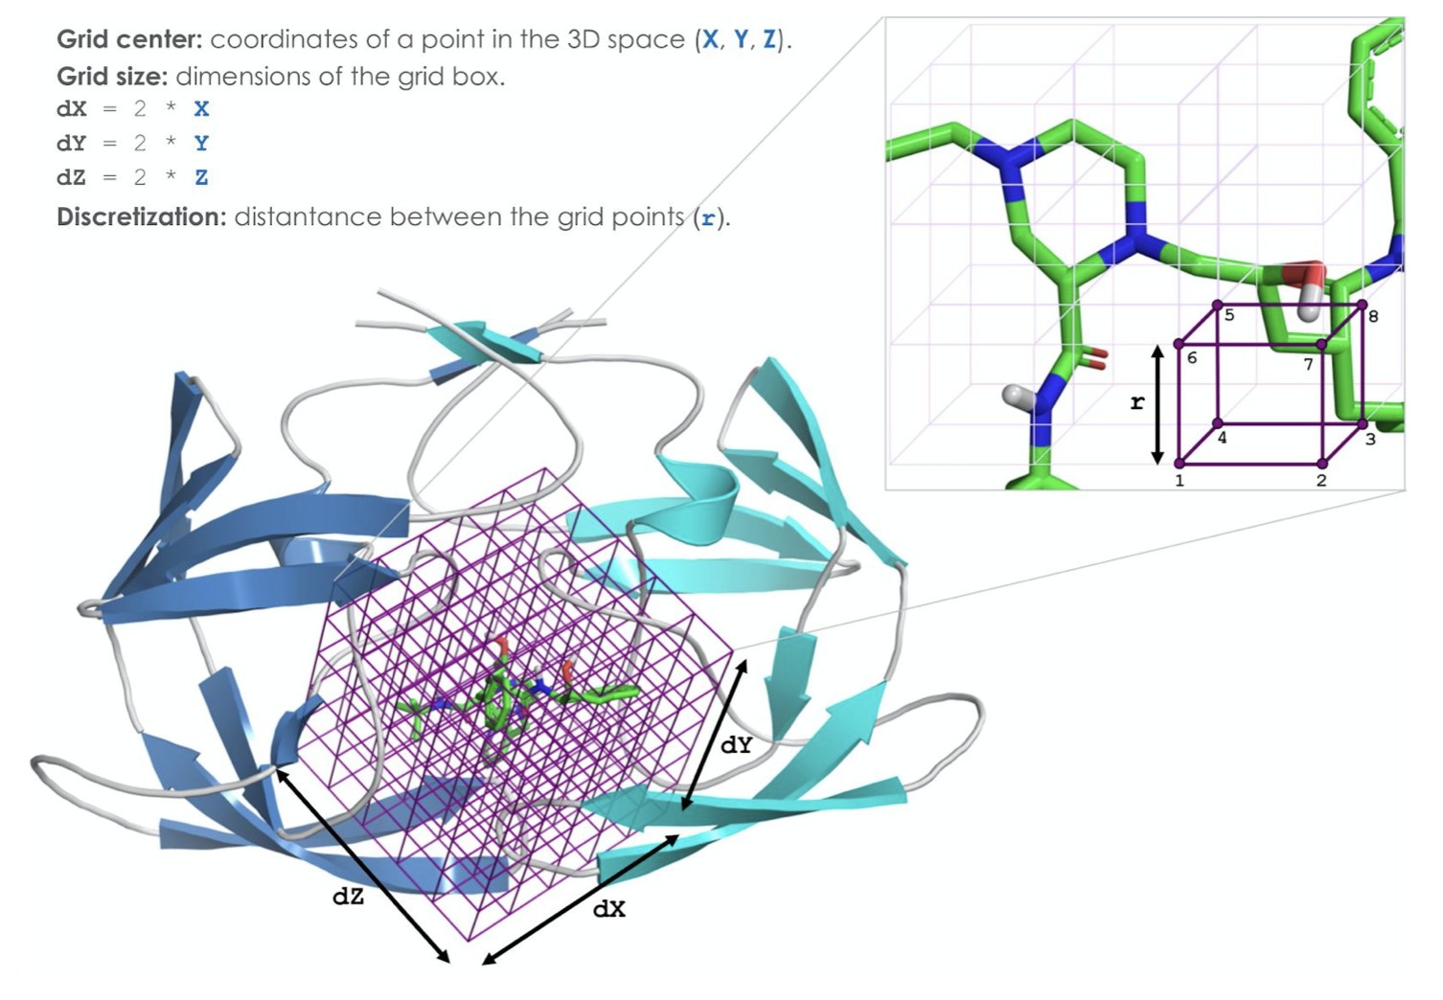
DockThor Docking page
In the last tab you can review the files you have added
To reduce computational costs in computing the binding poses and energies, DockThor uses a grid approach, which consists in a lattice of tridimensional points, where each point holds the total electrostatic and van der Waals potentials.
(we will come back to this topic later.)
X
Y
Z
In this tab you will also define the binding site within your protein, in terms of a “search box,” which is a defined space where the algorithm searches for the optimal position and orientation of the ligand relative to the protein. For this purpose, you have two options:
Set your own box center, dimensions, and distances between the points of the box, based on the protein biding site;
Let the entire protein to be searched.
Usually, it can be auto-defined for each ligand, but you have the option to change it, respecting the maximum number of points (950 000).
Adapted from: Guedes, I.A. Development of Empirical Scoring Functions for Predicting Protein-ligand Binding Affinity. D.Sc. Thesis, 2016.

Slide 31
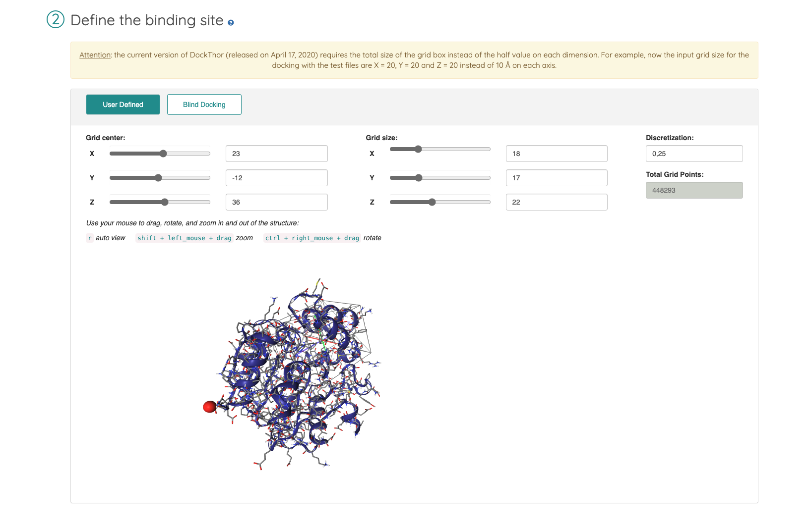
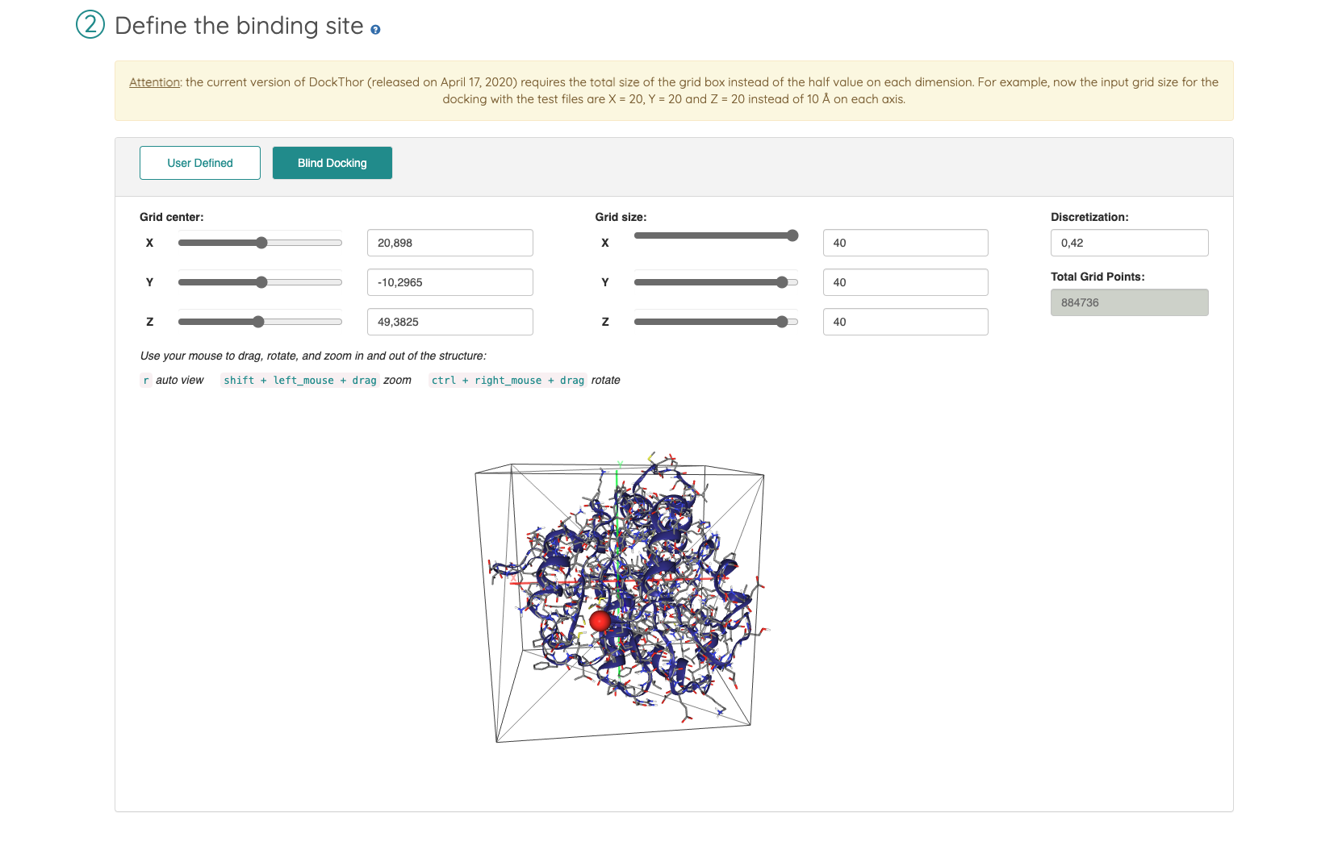
DockThor Docking page
Use defined set of search box parameters
Blind docking

Slide 32
DockThor Docking page
Use defined set of search box parameters
Blind docking
Let’s try it out! Choose which approach you would like to follow!
We will compare the results later =)

Slide 33
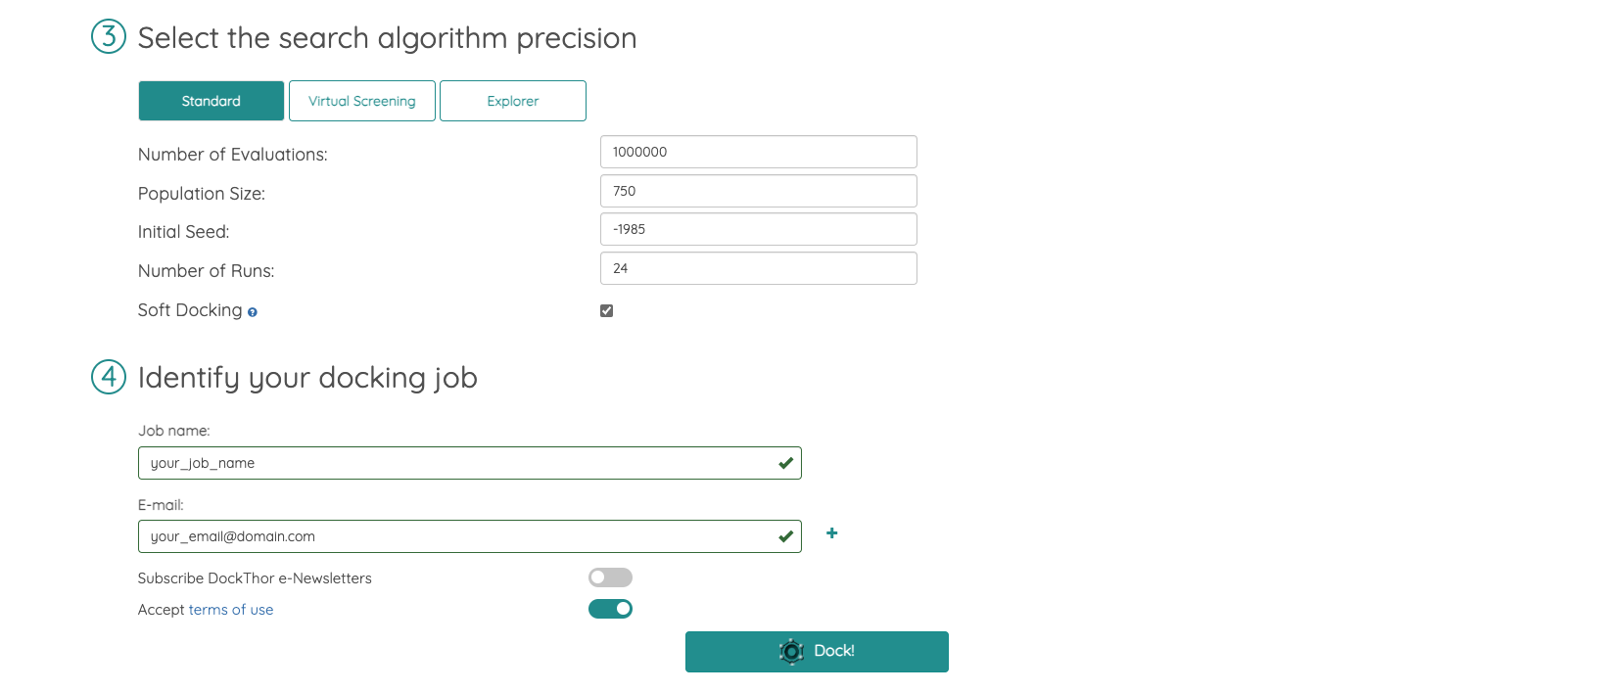
DockThor Docking page
After setting up your search box, the DockThor Portal allows you to modify certain parameters:
Number of evaluations per docking run (to find the best binding pose);
Number of individuals to be considered (population size);
Initial seed (to randomly generate the individuals of the population);
Number of docking runs;
Enabling the “Soft Docking” provides some flexibility to the receptor.

Slide 34
DockThor Docking page
This set of parameters have already been optimized by the DockThor developers, but you can modify them if know that your data requires it.
After setting up your search box, the DockThor Portal allows you to modify certain parameters:
Number of evaluations per docking run (to find the best binding pose);
Number of individuals to be considered (population size);
Initial seed (to randomly generate the individuals of the population);
Number of docking runs;
Enabling the “Soft Docking” provides some flexibility to the receptor.

Slide 35
DockThor Docking page
After setting up your search box, the DockThor Portal allows you to modify certain parameters:
Number of evaluations per docking run (to find the best binding pose);
Number of individuals to be considered (population size);
Initial seed (to randomly generate the individuals of the population);
Number of docking runs;
Enabling the “Soft Docking” provides some flexibility to the receptor.
You must choose one identifying name for your job, and provide a valid e-mail.

Slide 36
DockThor Docking page
After setting up your search box, the DockThor Portal allows you to modify certain parameters:
Number of evaluations per docking run (to find the best binding pose);
Number of individuals to be considered (population size);
Initial seed (to randomly generate the individuals of the population);
Number of docking runs;
Enabling the “Soft Docking” provides some flexibility to the receptor.
You must choose one identifying name for your job, and provide a valid e-mail.
After accepting the terms of use, you can submit it by clicking on the ”Dock” button.

Slide 37
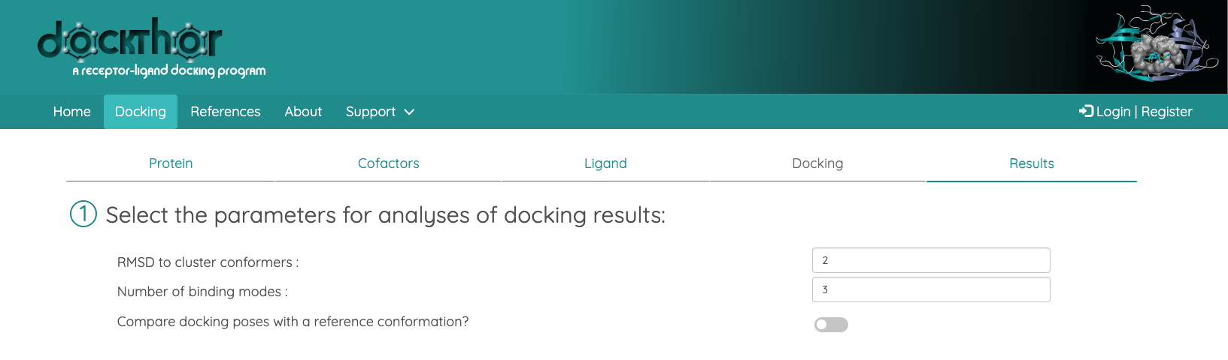
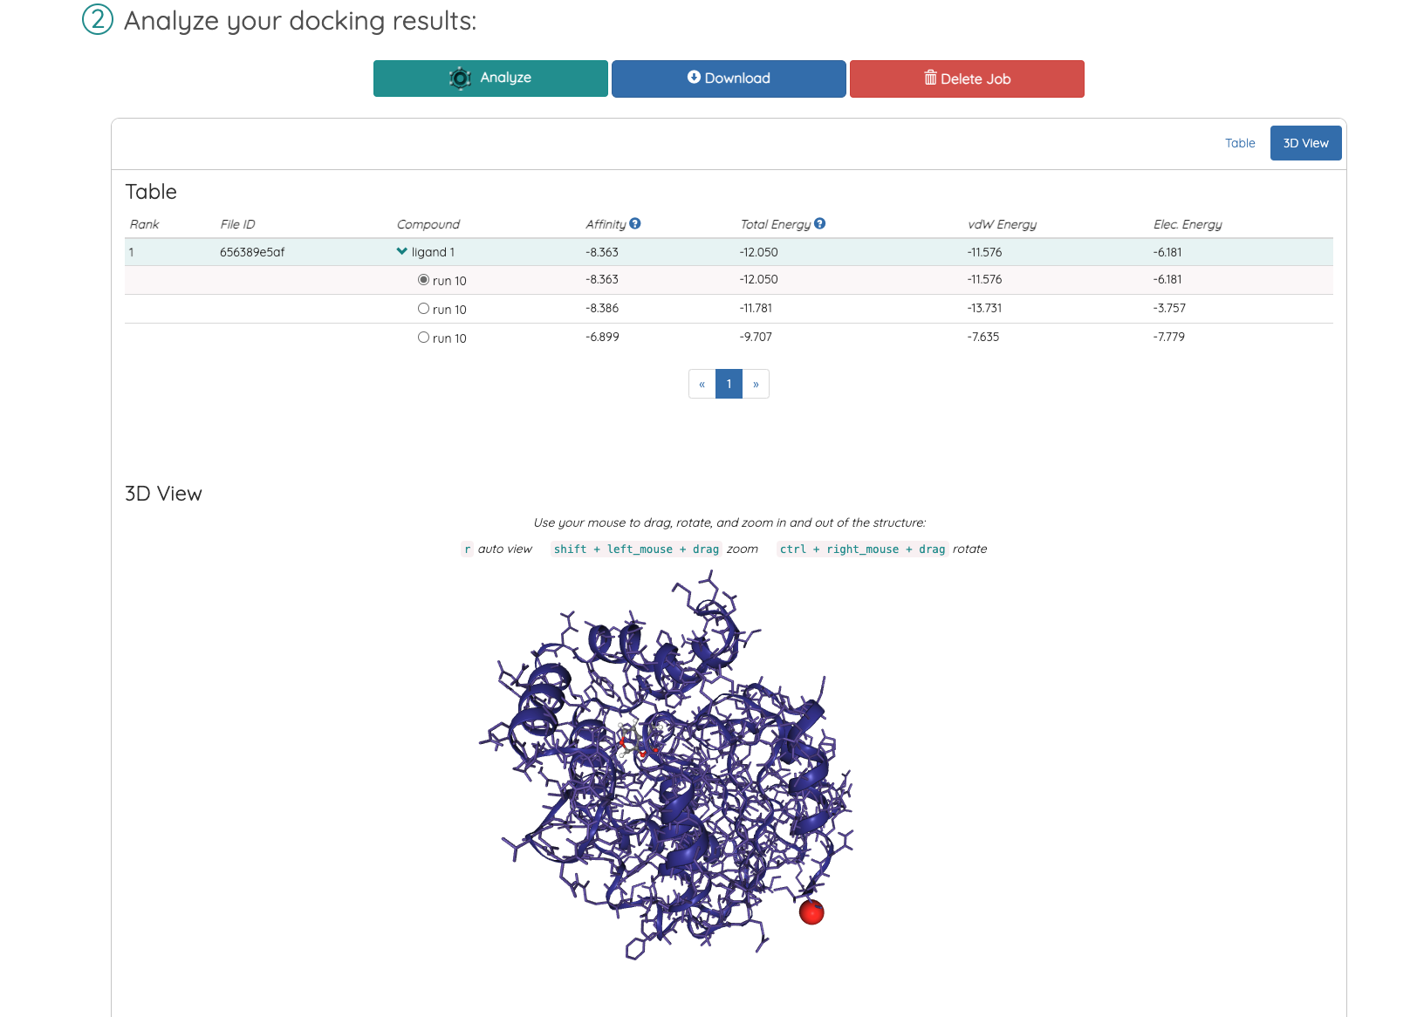
DockThor Analysis
Once your run is over, you will receive an e-mail with a link to access the “Results” page.

Slide 38
DockThor Analysis
Once your run is over, you will receive an e-mail with a link to access the “Results” page.
You can stablish your own RMSD clustering criteria, which means you can set how distant the conformer within a cluster can be.
You can also set the number of poses you would like to visualize.

Slide 39
DockThor Analysis
Once your run is over, you will receive an e-mail with a link to access the “Results” page.
You can stablish your own RMSD clustering criteria, which means you can set how distant the conformer within a cluster can be.
You can also set the number of poses you would like to visualize.
Click on “Analyze” to see your results.

Slide 40
DockThor Analysis
Once your run is over, you will receive an e-mail with a link to access the “Results” page.
You can stablish your own RMSD clustering criteria, which means you can set how distant the conformer within a cluster can be.
You can also set the number of poses you would like to visualize.
The docked poses that were obtained in all docking runs are clustered and ranked according to the total energy (composed by the intermolecular and intramolecular interactions, in terms of the electrostatic and van der Waals potentials, and the torsional energy of the ligand). For each docking run, only the top-ranked leaders of each cluster will be used to the final clustering analysis step.

Slide 41
DockThor Analysis
This column lists the best compounds and poses found in the docking runs. As we only used one compound to dock, only one will be listed here. However, the run number may change based on the input parameters you set before running the molecular docking, and the clustering criteria and number of binding mode you set for your analysis.

Slide 42
DockThor Analysis
The predicted affinity considers the total energy, and includes terms related to entropy and desolvation, to provide a more accurate representation of the binding environment.
This should only be taken into account when you are comparing 2 or more ligands.

Slide 43
DockThor Analysis
The Total Energy combines intermolecular protein-ligand interactions and intramolecular interactions in terms of van der Waals and electrostatic potentials, and the torsional energy of the ligand.
You should consider the most negative value as the best pose; however, a visual inspection is necessary to verify the binding modes.

Slide 44
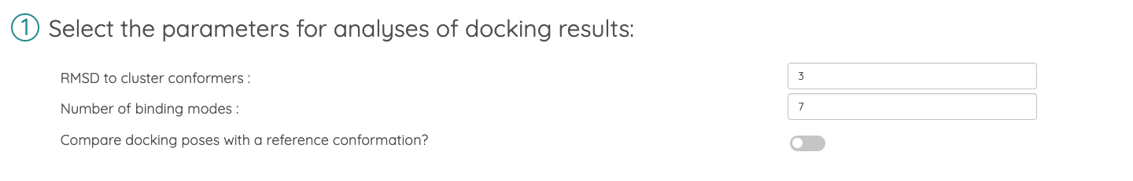
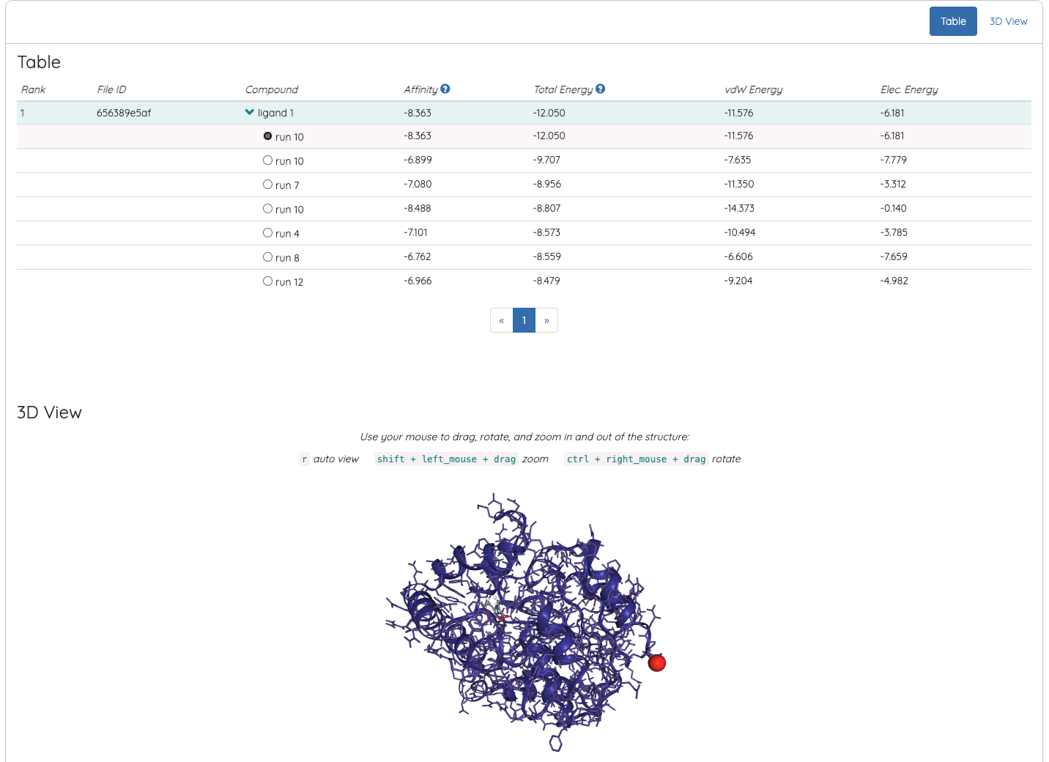
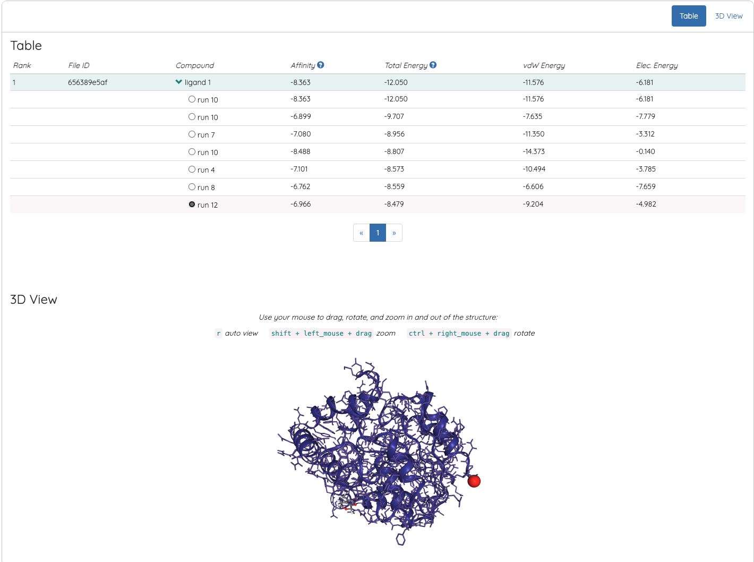
DockThor Analysis
Here are two examples of different sets of analysis parameters resulting in varying ranked poses and binding modes.

